Slide 1
Physics Simulation to facilitate NGSS Education

Slide 2

Outline
What my motivations for the project where.
NGSS Standards
What the project is.
System Architecture
Project Features
Simulation Challenges
Lesson Plan
Running the Program and Customization
Project Future

Slide 3
Project Motivations
Helping to construct a mental model.
Brian Greene.
Computational Physics.
Space is cool.

Slide 4
Next Generation Science Standards(NGSS)
New education standards designed to be "rich in content and practice.”
Provide an internationally benchmarked science education.
Emphasize critical thinking and primary investigation

Slide 5
Why NGSS is Important
Expected to be adopted by all states in next few years.
Nevada is one of eleven states who have already adopted the standards.
Helps prepare students for all careers in the modern workforce
Provides scientific and technological literacy for an educated society.

Slide 6
Why NGSS Is Important
Lagging achievement of U.S. students
The 2012 Program for International Student Assessment (PISA) ranks the United States as 23rd in Science, 30th in Math, and 20th in Reading Literacy out of 65 OECD education systems.
Over a third of eighth-graders scored below basic on the 2011 NAEP Science assessment.
Reduction of U.S. competitive economic edge.
Foreign competitors filed over half o U.S. technology patent applications in 2012.
Correspondingly, the United States' high-tech trade deficit continues to grow.

Slide 7
Why Help is needed to adopt standards.
Many incoming students will have deficits.
Technology has the potential to enhance learning.
There are few materials available to help teachers adapt to new standards.

Slide 8
Project Introduction
The simulation is primarily focused on middle school science standards.
Aims to facilitate students to build a mental model.
Aims for students to investigate and make their own realizations about the system.

Slide 9
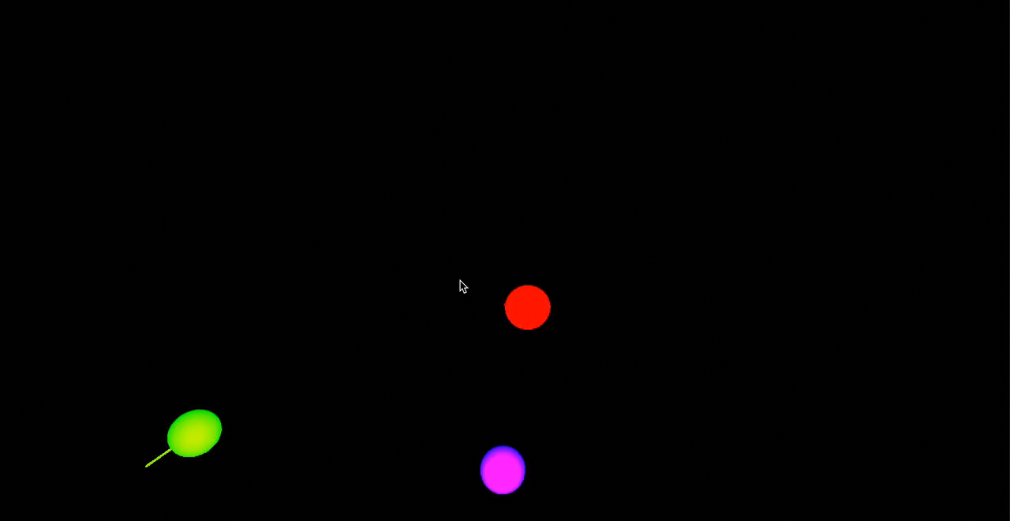
Project Evolution
Initial Prototype of interacting objects.

Slide 10
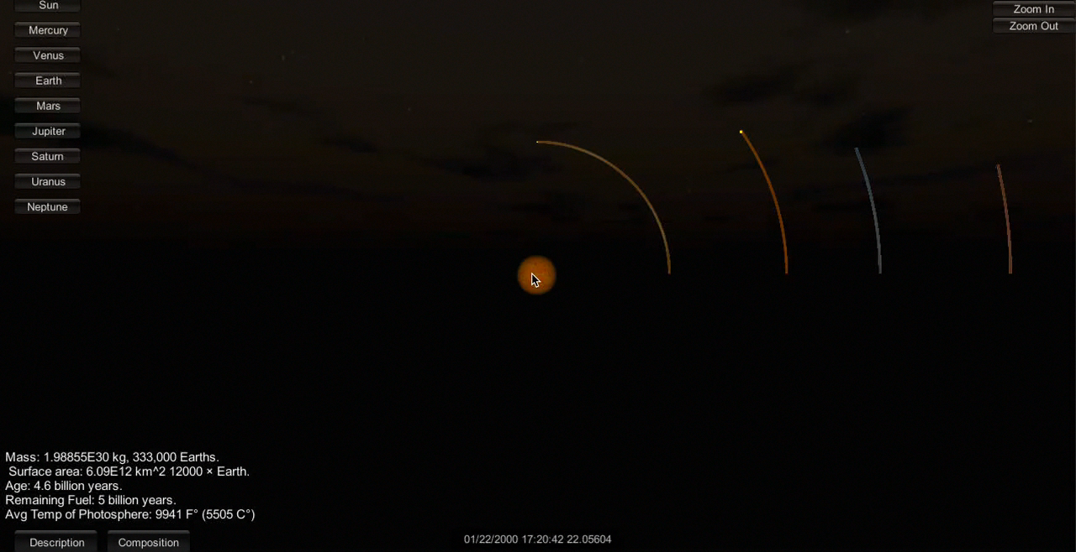
Project Evolution
I decided to focus on our solar system, and the NGSS standards instead of a purely theoretical physics system.

Slide 11
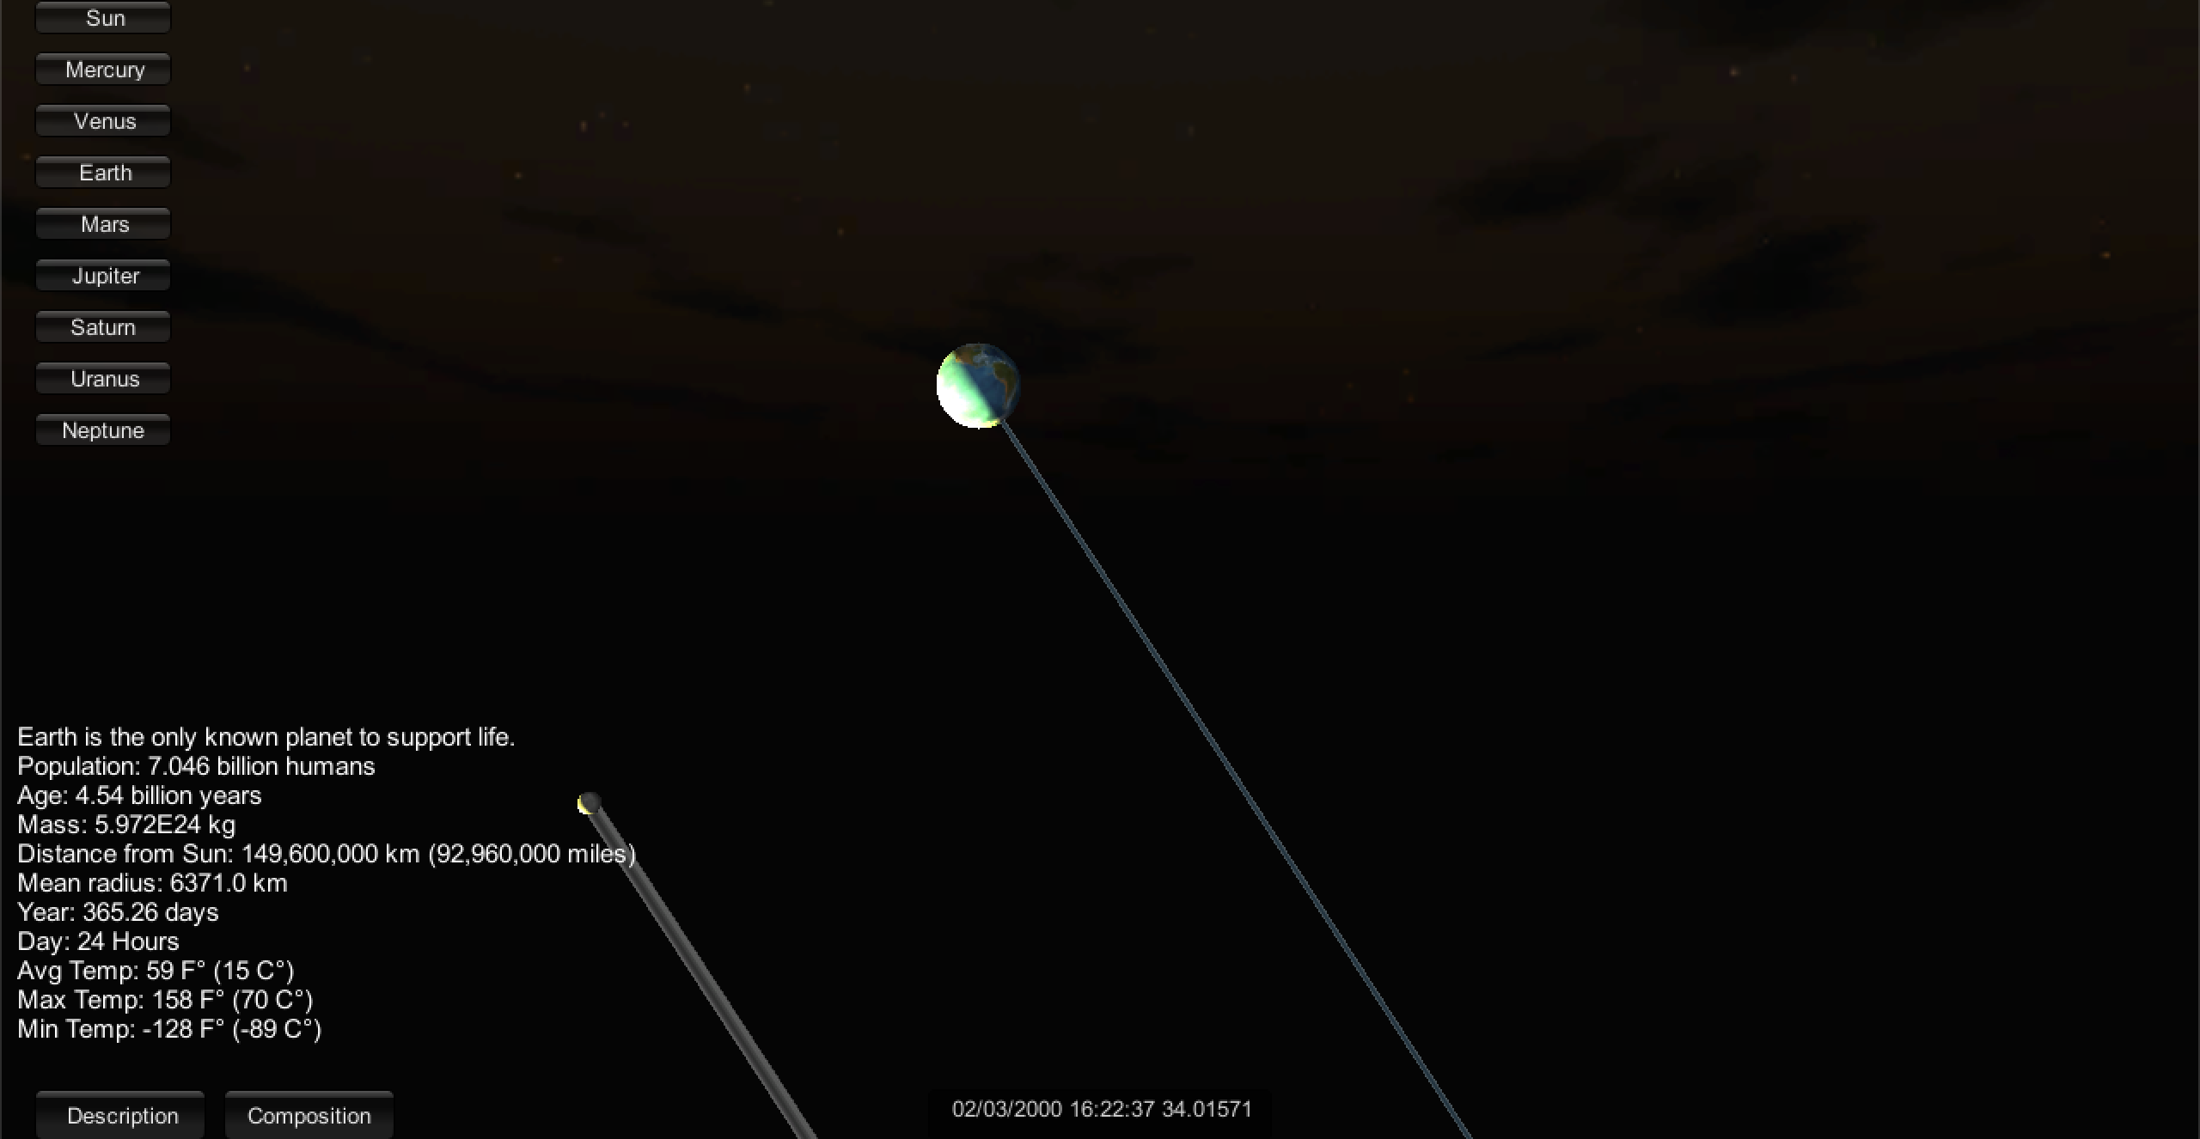
.
The Moon orbiting around the Earth.

Slide 12
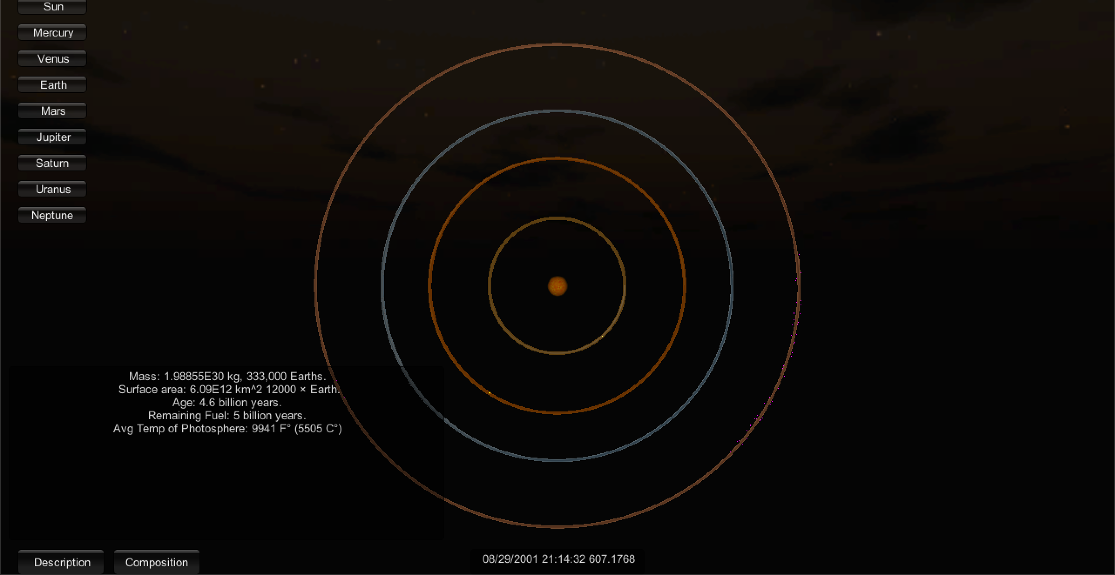
Screenshot of the inner planets and their rotation around the sun

Slide 13
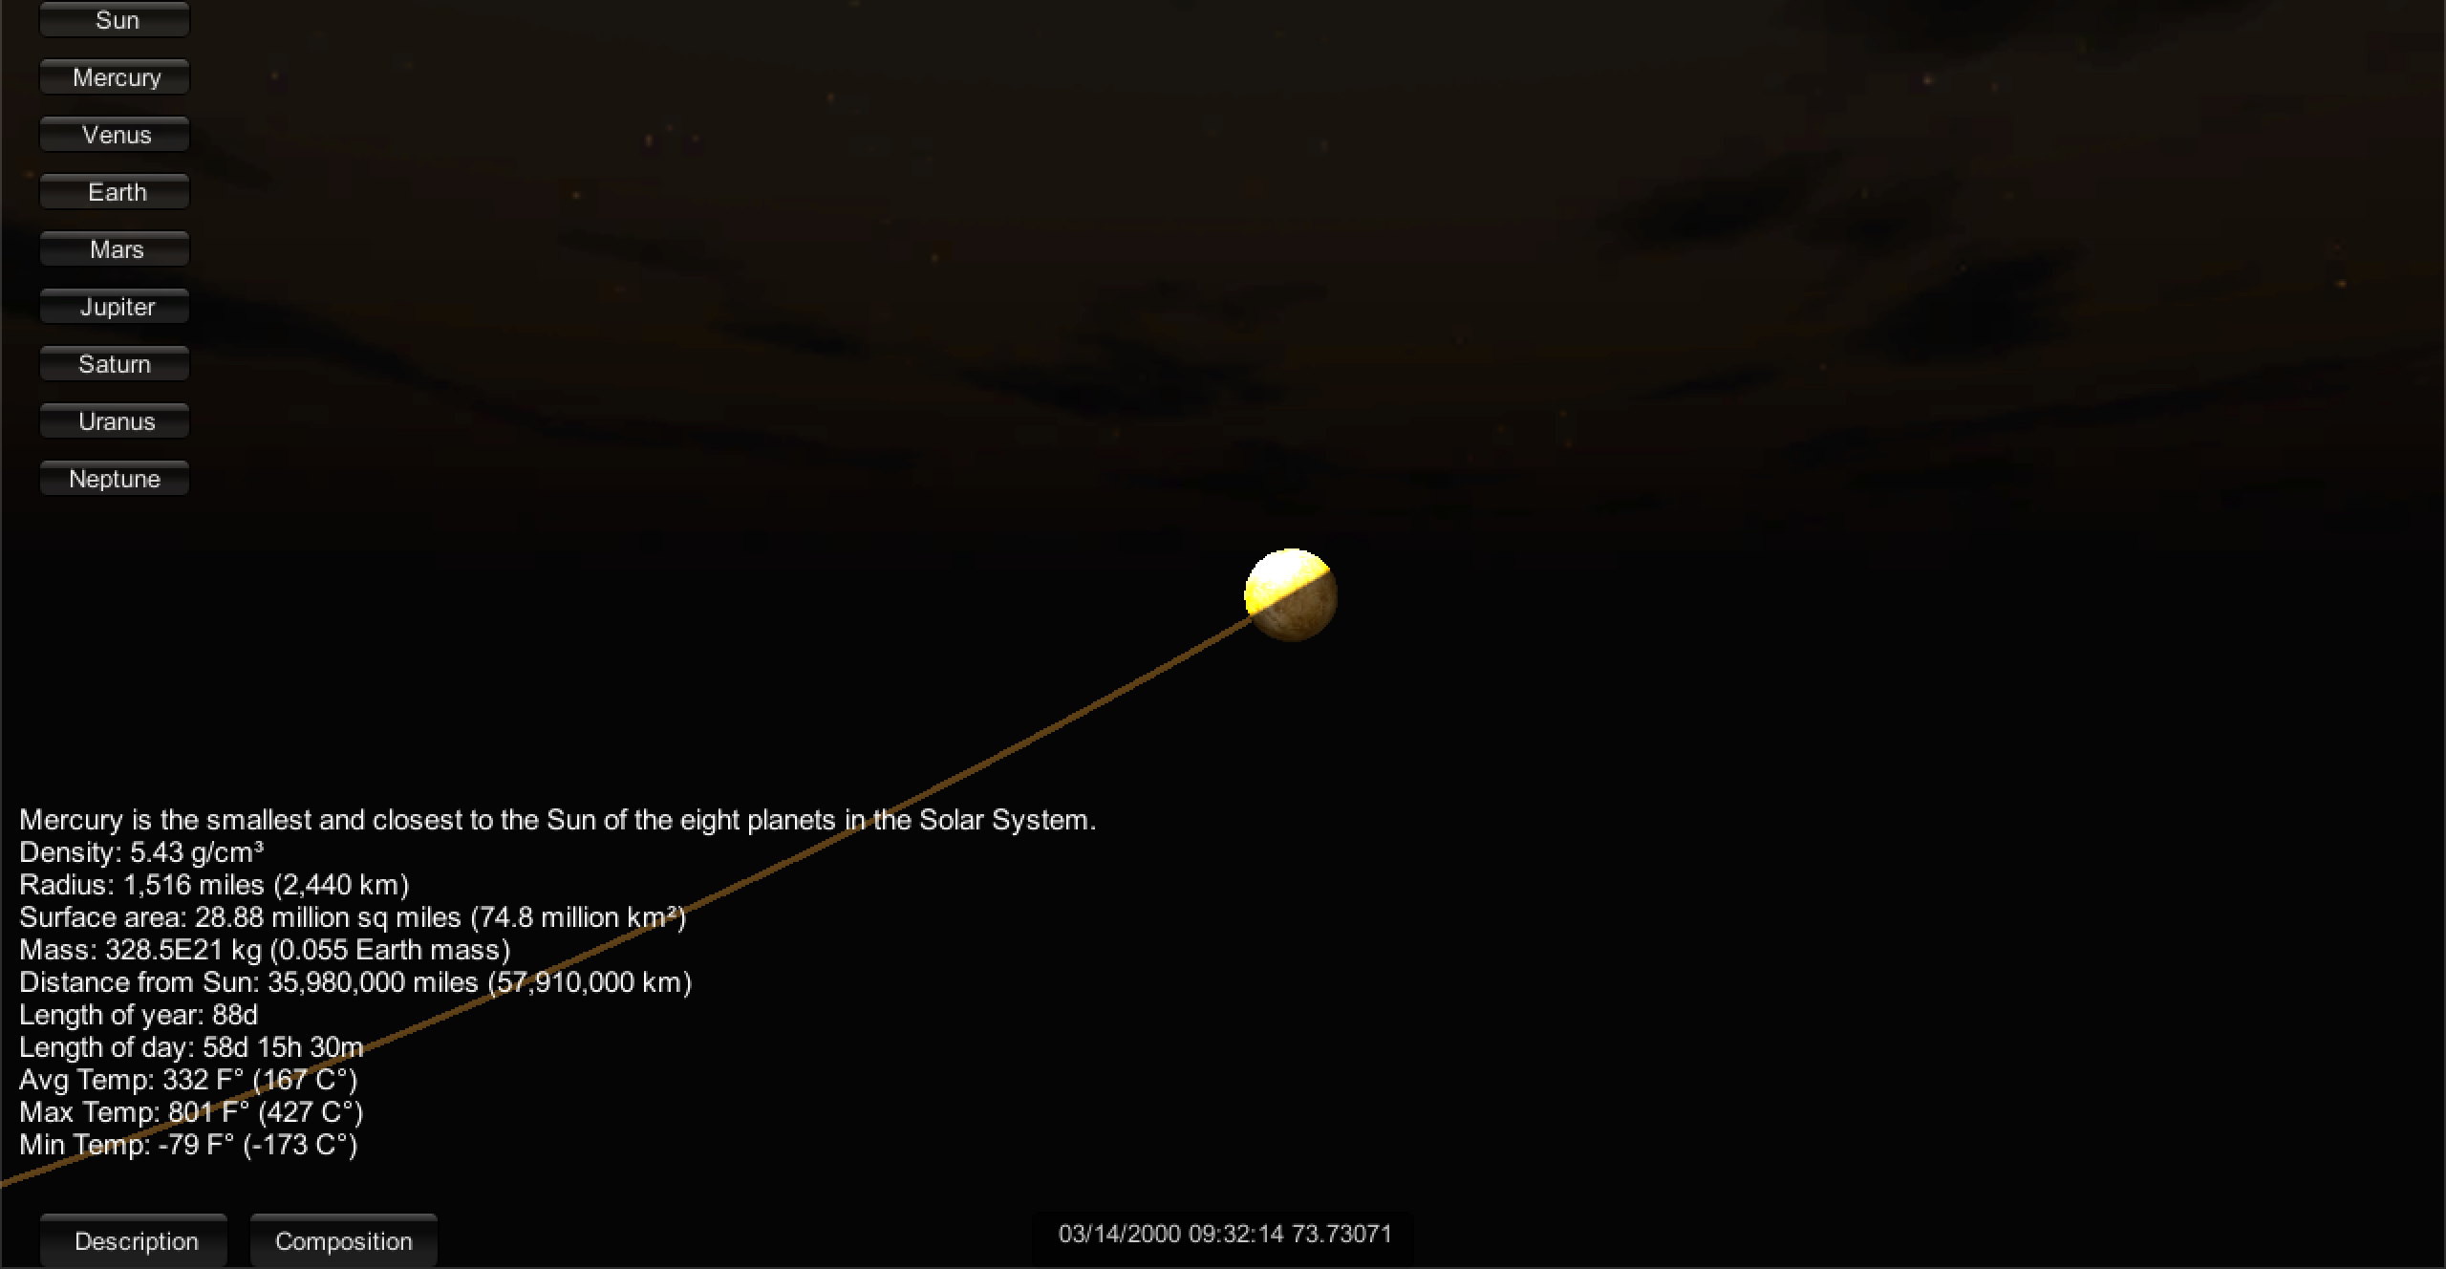
Planet Mercury

Slide 14
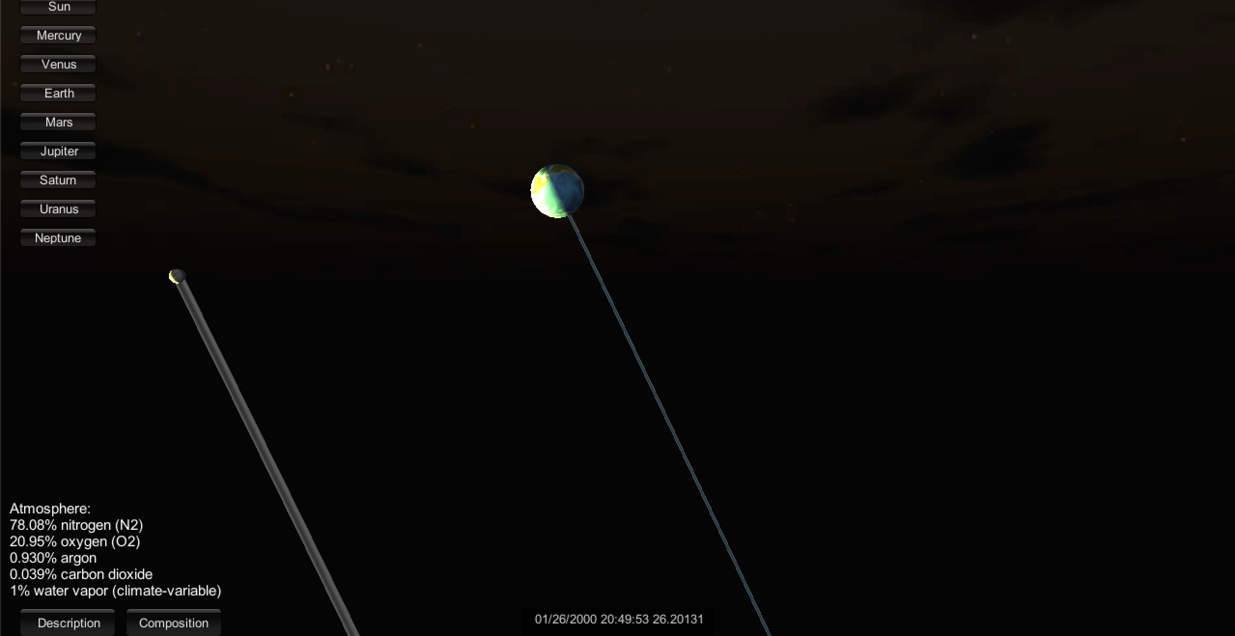
You can also view planet compositions.

Slide 15
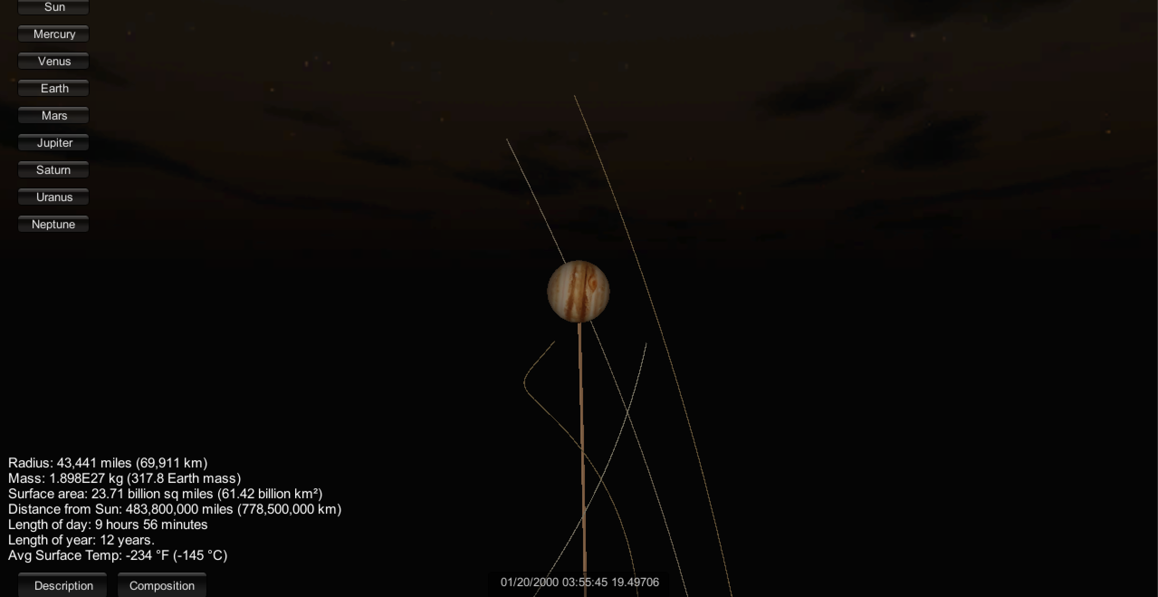
Jupiter and the Galilean Moons

Slide 16
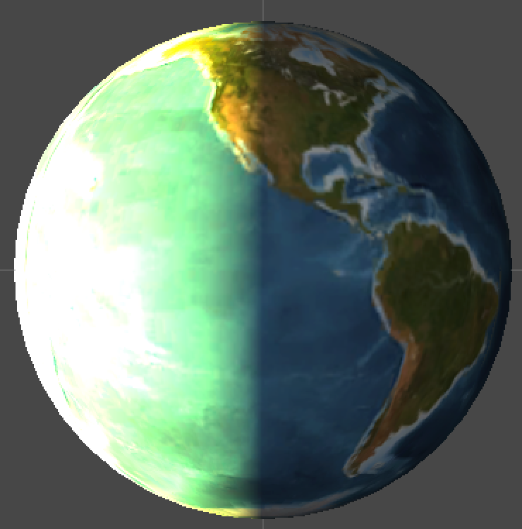
Lighting shows students what causes the day and night cycle.

Slide 17
Architecture
Unity3D Engine
3D Rendering/Texturing/Compiling
C#
Physics engine, Input Control, etc

Slide 18
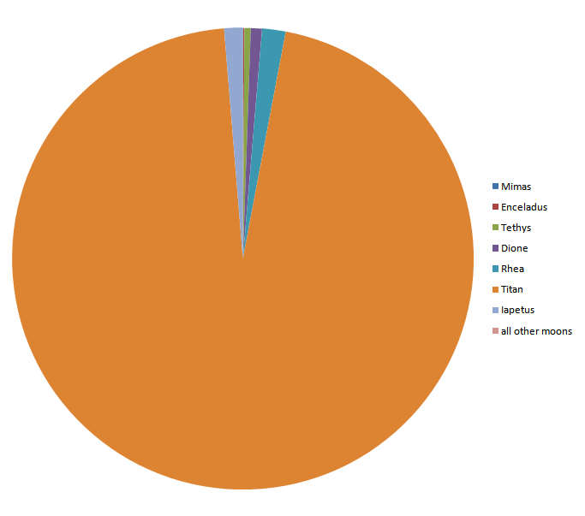
Simulation Challenges
Due to scaling, many moons, especially Jupiter’s, do have modified locations.
Some planets have lots of very distant, hard to see moons(again, Jupiter).
Saturn’s Moons by mass.

Slide 19
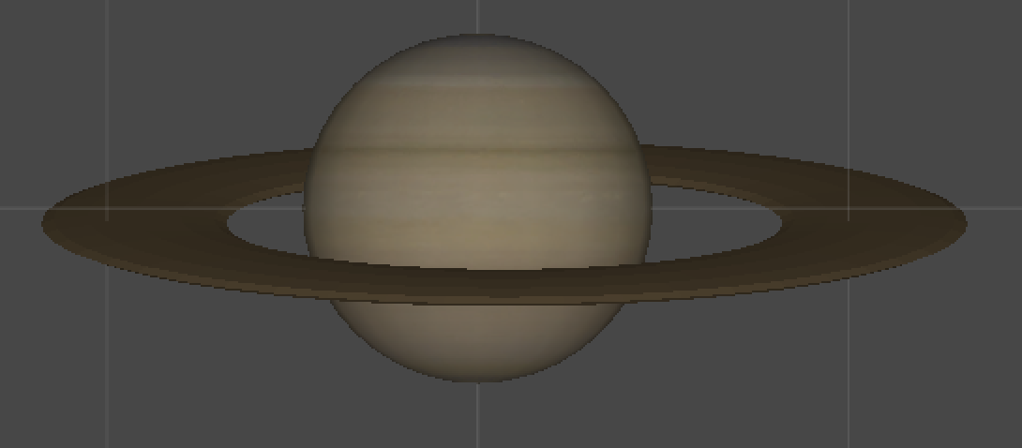
Simulation Challenges
Many things in the solar system happen at very different time intervals.
Challenging to render ring’s cleanly.

Slide 20
Lesson Plan - NGSS
DMS-ESS1-2
Develop and use a model to describe the role of gravity in the motions within galaxies and the solar system.
Examples of models can be physical (such as the analogy of distance along a football field or computer visualizations of elliptical orbits) or conceptual (such as mathematical proportions relative to the size of familiar objects such as students' school or state).]

Slide 21
Lesson Plan - NGSS
ESS1.B: Earth and the Solar System
The solar system consists of the sun and a collection of objects, including planets, their moons, and asteroids that are held in orbit around the sun by its gravitational pull on them.
The solar system appears to have formed from a disk of dust and gas, drawn together by gravity.

Slide 22
Lesson Plan - NGSS
MS-ESS1-3: Earth's Place in the Universe
Analyze and interpret data to determine scale properties of objects in the solar system. Examples of scale properties include the sizes of an object’s layers (such as crust and atmosphere), surface features (such as volcanoes), and orbital radius.

Slide 23
Lesson Plan - Topics
The structure, scale, and movement of our solar system.
The place of the Earth within our solar system.
How the movement of the planets effects days and years.
The concept of what a planet’s year and day is.
The role of the sun in our solar system.
The variation of bodies within the solar system, but not memorizing specific facts about them.

Slide 24
Lesson Plan - Take Away
How gravity effects the motions of all of the bodies within the universe.
How the sun holds the solar system together, due to its massive size.
Similarities and differences between the planets.
The massive scale of the solar system, and the universe

Slide 25
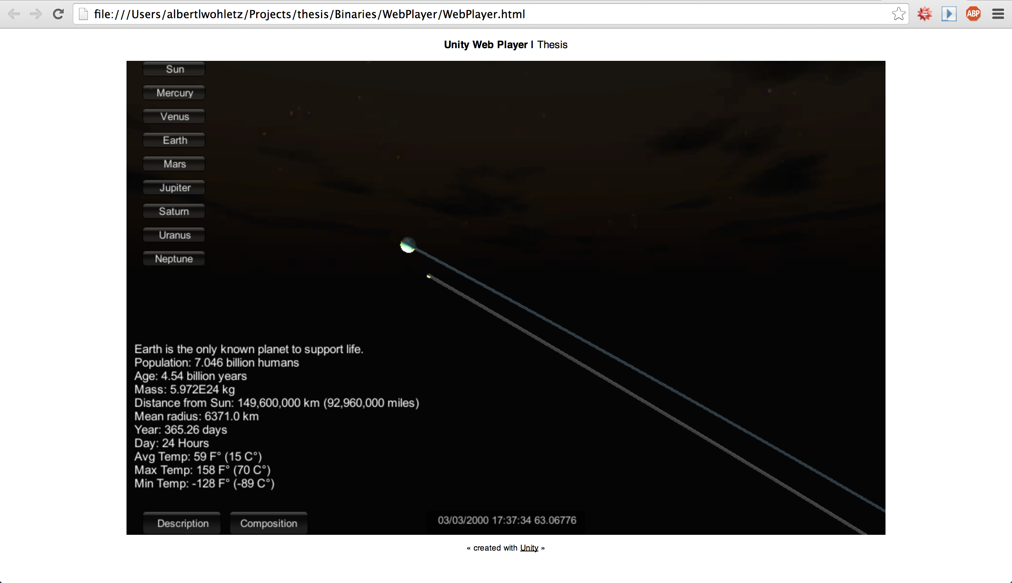
Running the Program
Currently available on Windows, Mac, Linux (OpenGL), Chrome, and Web(Unity Plugin).

Slide 26
Customization
Many levels and varieties of classes.
Teachers should be able to adapt the program to their class as they can edit the lesson plan.
Teachers should be able to do this easily, without needing to know programming languages.

Slide 27
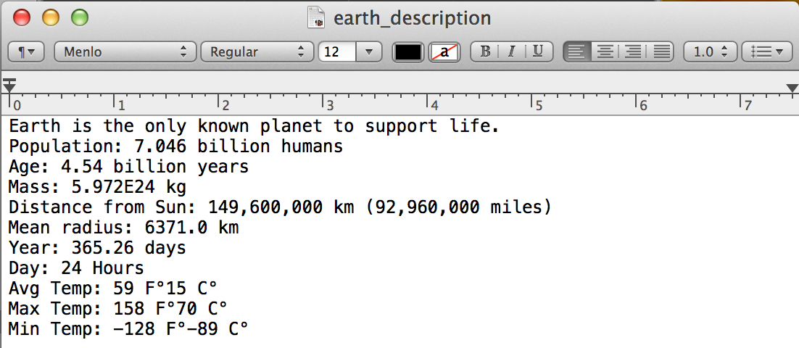
Customization
All text elements in program, are read in from easily editable text files.

Slide 28
Project Availability
Source code/Binaries:
https://github.com/albertwohletz/solarsimulator/
Web Player demo: http://54.183.0.32/.

Slide 29
Project future
Models of more systems/More Customization options.
More Physics simulations.
Dynamic planet simulation.
Entire project available on Github.
https://github.com/albertwohletz/solarsimulator

Slide 30
Conclusion
What my motivations for the project where.
NGSS Standards
What the project is.
System Architecture
Project Features
Simulation Challenges
Lesson Plan
Customization
Project Future

Slide 31
Questions?

